Slide 1
Where to open an Indian Restaurant & Bar in USA
By- Ekaansh Khosla

Slide 2
Introduction
As we many Indians migrate from India to USA, whether it is for higher studies, or getting a job so it is very nice idea to open up things for them so they hang out with their Indian as well as American friends.
As we know that an average person likes to eat in his or her cultural
so if it is possible that an Indian Restaurant could be open in USA then it will be great for the business men and as well as Indians.
By doing this we could also introduce Indian culture to Americans as well as people other than Indians and Americans who have migrated from their countries.

Slide 3
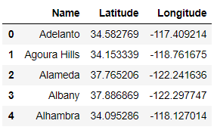
Data
I collected data for various places in California as well as Los Angeles from Kaggle [1] [2].
California data was in the following format Table 1:
Table 1. Data format of California

Slide 4
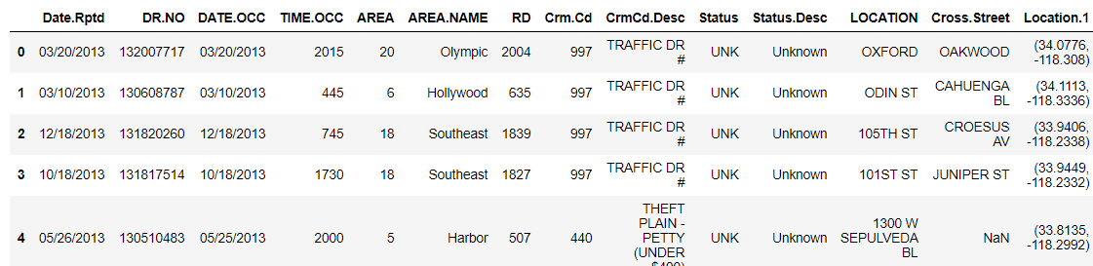
So I got a readymade data which I could use for my analysis. After analyzing this data using foursquare API, I got to know that Los Angles would be the most suitable place to open up an Indian Restaurant.
So we got Los Angeles data from Kaggle in the following format Table 2:
Table 2. Data format of Los Angles

Slide 5
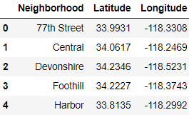
Table 3. Refined Data format of Los Angles

Slide 6
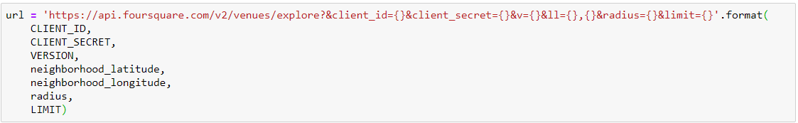
Methodology
Figure 1. Code for exploring different places in California.

Slide 7
Figure 2. Code for exploring different places in Los Angeles.

Slide 8
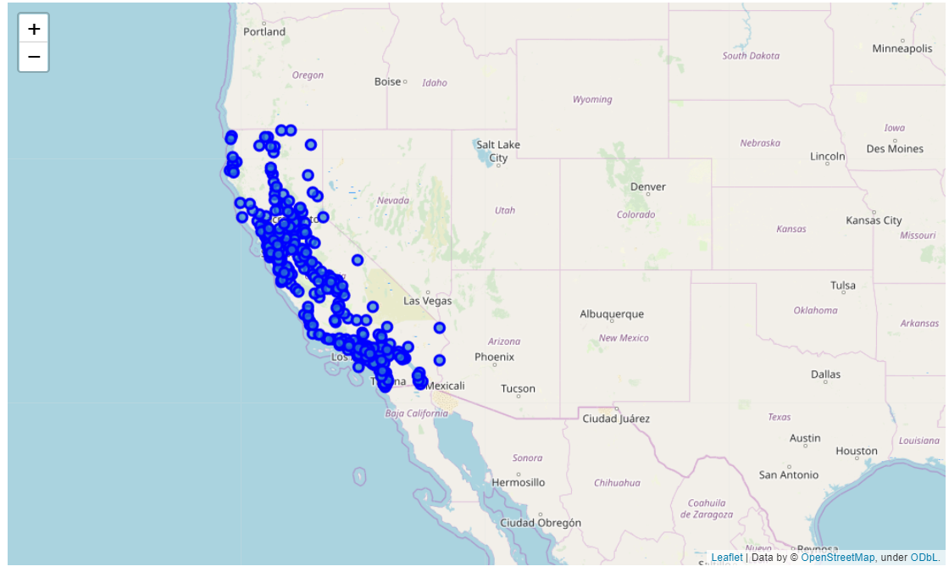
Results
Figure 3. Places in California of which data was given on Kaggle data set.

Slide 9
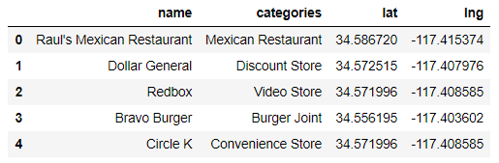
Table 4. Name of venues by its category

Slide 10
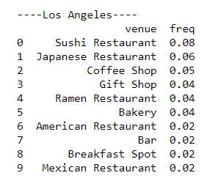
So after exploring I decided to open a restaurant and Bar in Los Angeles as there is no Indian Restaurant and Bar in its most frequent places. The most frequent venues data of Los Angeles is as follows Figure 5:
Figure 5. Most frequent places in Los Angeles

Slide 11
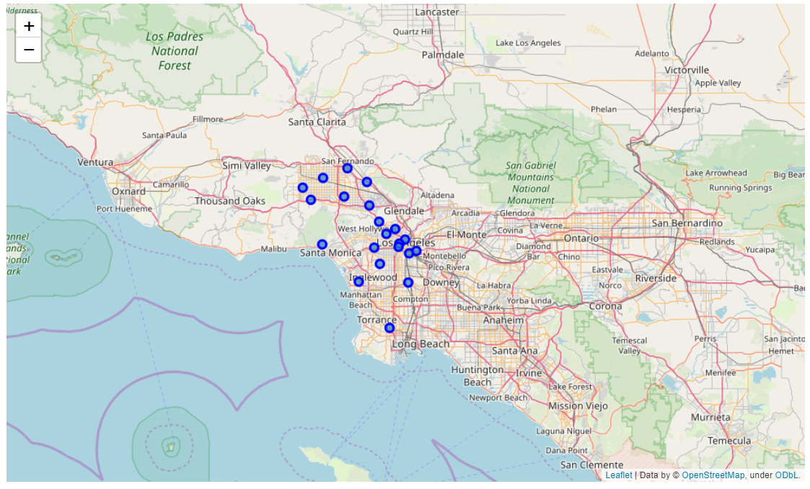
Figure 6. Places in Los Angeles of which data was given on Kaggle data set.

Slide 12
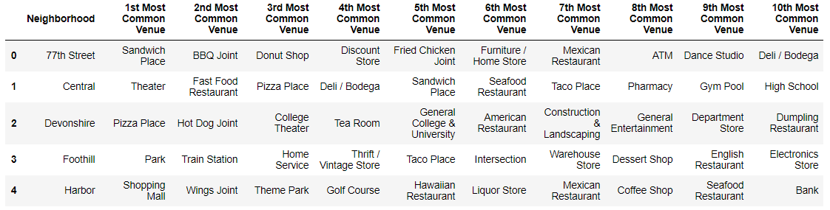
Table 6. Sorted every venue category according to its frequency at a place

Slide 13
Hence from the data we got to know that there are not much Places to have food near Wilshire so we can setup an Indian restaurants there and as Liquor store is most common we can open a Restaurant & Bar over there where Indian people as well as American can have their drinks with Chicken tandoori, butter Chicken and all the awesome Indian food.
Wilshire
Warehouse Store 0.2
Discount Store 0.2
Liquor Store 0.2
Salvadoran Restaurant 0.2
Furniture / Home Store 0.2
Motel 0.0
Movie Theatre 0.0
Moving Target 0.0
Museum 0.0
Music Store 0.0

Slide 14
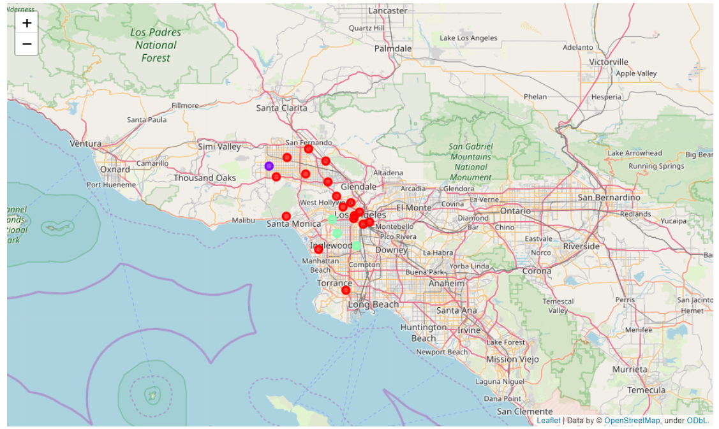
Figure 7. Clustering of venues in Los Angles.

Slide 15
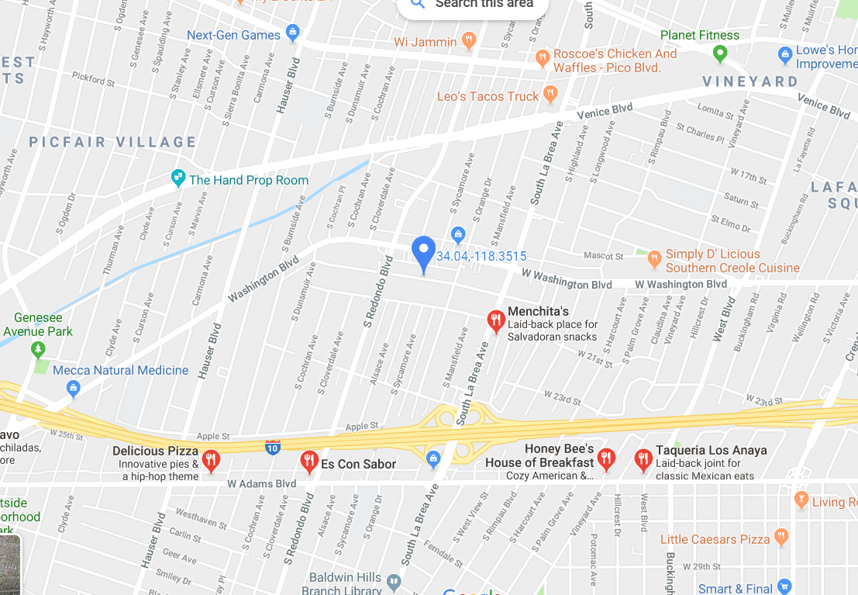
Figure 8. Google Maps, Restaurants in Wilshire

Slide 16
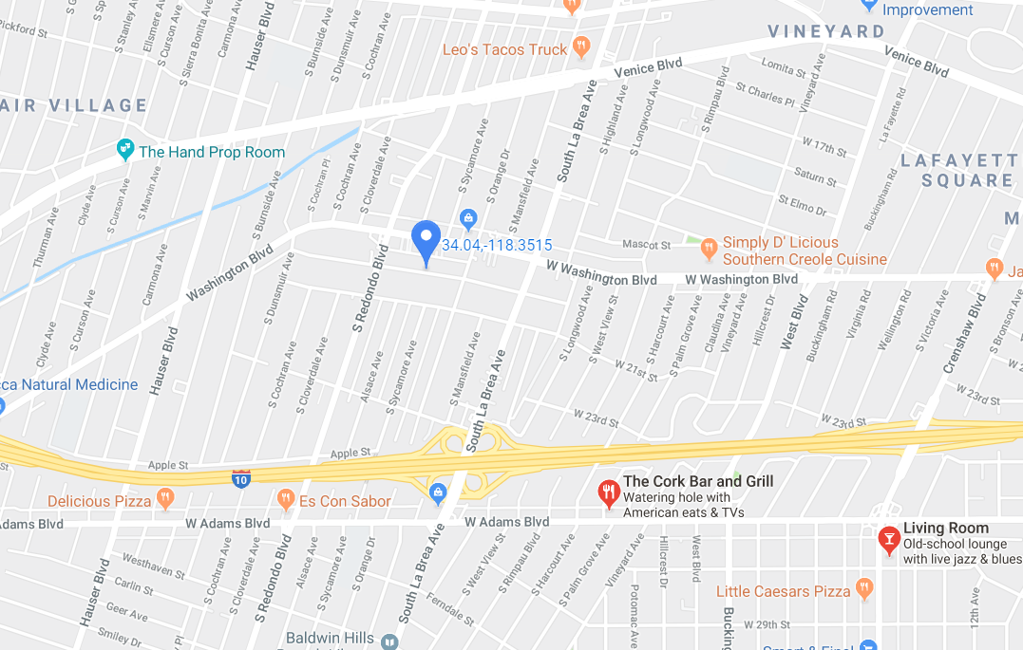
Figure 9. Google Maps, Bars in Wilshire

Slide 17
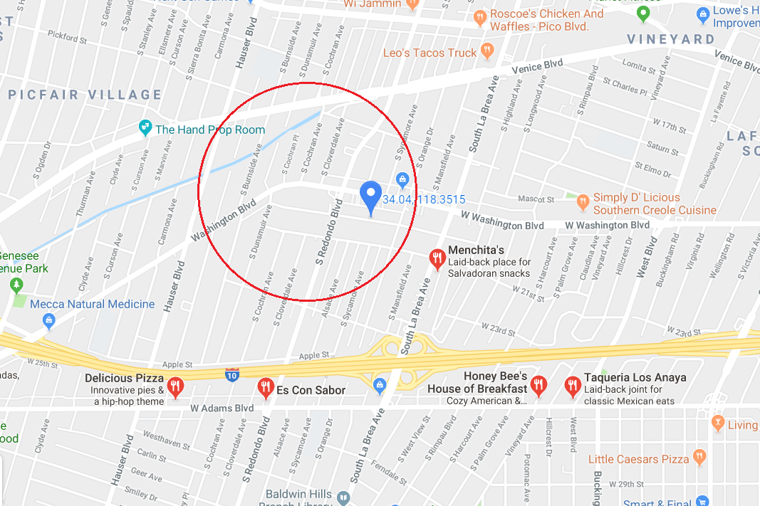
Figure 10. Place where and Indian Restaurant & Bar can be opened.

Slide 18
5. Discussions
From the study we got to know that foursquare API is a great tool to explore new places around the world. In the study I observed that we can apply many machine learning models in order to find a suitable spot for many activities for the people over that place.
I have little suggestion that is the foursquare API would have been more accurate then we could have performed the above study more accurately.

Slide 19
6. Conclusions
We successfully suggested the place where we can set up an Indian Restaurant and Bar in Los Angeles by using foursquare API and K-Means clustering.
But if the foursquare API would have been more accurate then we could have performed the above study more accurately, and we could have suggested business people about the place more accurately so that it would have been profitable for both business people as well as people living in that region.

Slide 20
References
https://www.kaggle.com/camnugent/california-housing-feature-engineering
https://www.kaggle.com/kingburrito666/los-angeles-crime

